Slide 1
Spring Boot Logging
Real Production Logging for Backend Engineers
Topics:
Structured Logging
Correlation ID
Exception Tracking
Async Logging, ELK Stack

Slide 2
Why Logging Matters
Logs are the production story of your application. Without logs debugging production becomes impossible.

Slide 3
Real Production Incident
Payment failures Kafka retries Slow APIs Customer complaints How do we debug?

Slide 4
Logging Levels
TRACE → Deep execution flow DEBUG → Developer debugging INFO → Business events WARN → Recoverable issues ERROR → Production failures

Slide 5
Log Hierarchy
TRACE DEBUG INFO WARN ERROR

Slide 6
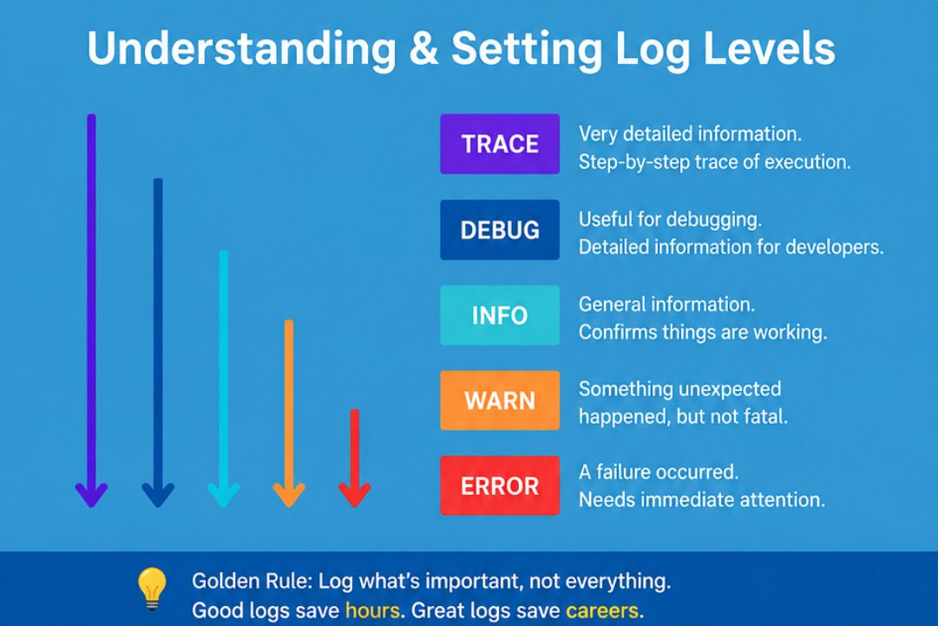

Slide 7
Spring Boot Default Logging
Spring Boot uses Logback by default. Default logs contain timestamp, thread, level, logger name.
@RestController public class OrderController { @GetMapping("/orders") public String getOrders() { return "Orders fetched"; } }

Slide 8
Avoid System.out.println
System.out.println is not production logging.
System.out.println("Order Created");

Slide 9
SLF4J Logging
Use Lombok @Slf4j with parameterized logging.
@Slf4j @RestController public class OrderController { @GetMapping("/orders") public String orders() { log.info("Fetching orders"); return "success"; } }
Example:
2026-06-06 INFO 12345 --- [nio-8080-exec-1] OrderController : Orders fetched

Slide 10
Structured Logging
Always log meaningful structured data.
log.info( "Order created orderId={} customerId={} amount={}", orderId, customerId, amount );

Slide 11
Real Project Example
Client → Order Service → Payment Service → Kafka → Notification Service

Slide 12
Microservice Debugging Problem
How to trace one request across multiple services?

Slide 13
Correlation ID
Correlation ID helps trace requests across services.
@Component public class CorrelationIdFilter implements Filter { @Override public void doFilter( ServletRequest request, ServletResponse response, FilterChain chain) throws IOException, ServletException { String correlationId = UUID.randomUUID().toString(); MDC.put("correlationId", correlationId); try { chain.doFilter(request, response); } finally { MDC.clear(); } } }

Slide 14
Log Pattern Configuration
Add correlationId into every log line.
logging: pattern: console: "%d [%thread] %-5level %logger - [%X{correlationId}] %msg%n"

Slide 15
Service Layer Logging
Log start and completion of business operations.
@Slf4j @Service public class OrderService { public void createOrder(Long orderId) { log.info("Starting order creation orderId={}", orderId); log.info("Order creation completed orderId={}", orderId); } }

Slide 16
Exception Logging
Always log exception stacktrace.
❌ Bad:
catch (Exception e) {
log.error("Error");
}
catch (Exception e) { log.error( "Payment failed orderId={}", orderId, e ); }

Slide 17
Global Exception Handler
Centralized exception handling.
@RestControllerAdvice @Slf4j public class GlobalExceptionHandler { @ExceptionHandler(Exception.class) public ResponseEntity<String> handleException(Exception ex) { log.error("Unhandled exception occurred", ex); return ResponseEntity .internalServerError() .body("Something went wrong"); } }

Slide 18
Performance Logging
Track API execution time.
@Component @Slf4j public class RequestTimingFilter implements Filter { @Override public void doFilter( ServletRequest request, ServletResponse response, FilterChain chain) throws IOException, ServletException { long start = System.currentTimeMillis(); chain.doFilter(request, response); long end = System.currentTimeMillis(); log.info("API execution time={}ms", (end - start)); } }

Slide 19
Async Logging
Async logging improves application performance.
<appender name="ASYNC" class="ch.qos.logback.classic.AsyncAppender"> <appender-ref ref="STDOUT"/> </appender>

Slide 20
File Logging
Store logs into files.
logging: file: name: logs/application.log

Slide 21
Centralized Logging Architecture
Application Logs → Logstash → Elasticsearch → Kibana

Slide 22
Production Mistakes
Avoid logging sensitive data. Avoid logging inside loops.
for(int i=0;i<100000;i++){ log.info("Inside loop"); }

Slide 23
Best Practices
Use structured logging Use proper log levels Avoid sensitive information

Slide 24
Interview Questions
Difference between DEBUG and TRACE? Why use MDC? Why async logging?

Slide 25
Final Message
Logs are not just debugging tools. Logs are the production story of your application.

Slide 26
Thank you…

